Slide 1

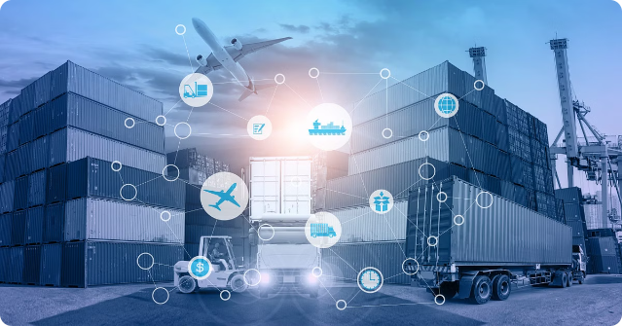
SUPPLY CHAIN
Of FMCG
A supply chain is the network of organizations, resources, and activities involved in the production and delivery of a product or service. It encompasses everything from sourcing raw materials to distributing the final product to customers.
AV

Slide 2

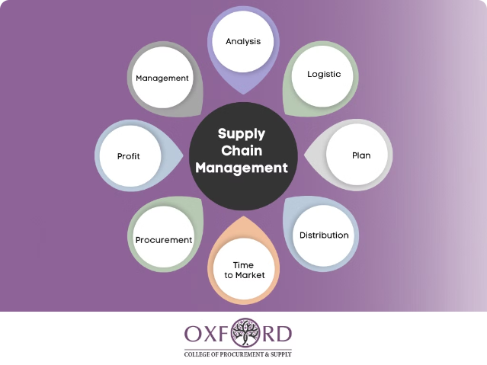
Purpose of a Supply Chain
The primary purpose of a supply chain is to ensure the efficient and effective flow of goods, information, and finances. A well-designed supply chain can improve customer satisfaction, reduce costs, and increase profitability for the organization.

Slide 3

On-Time Delivery
Shipment
Order Placement
The product is shipped to the customer within the promised delivery time.
Customers place an order for a product or service.
1
2
3
Order Processing
The company processes the order and prepares it for delivery.
On-time delivery refers to the ability of a supply chain to deliver orders to customers within the promised time frame. This is a critical metric for measuring customer satisfaction and supply chain efficiency.

Slide 4

In-Full Delivery
What is In-Full Delivery?
Importance of In-Full Delivery
Impact on the Supply Chain
In-full delivery means that the entire order quantity is delivered to the customer, without any shortages or missing items.
Delivering orders in full helps maintain customer trust, reduce returns, and ensure the customer receives the complete product they ordered.
Achieving in-full delivery requires effective inventory management, transportation planning, and coordination across the supply chain.

Slide 5

On-Time In-Full Delivery
Definition
Benefits
On-time in-full (OTIF) delivery is the combination of on-time delivery and in-full delivery, ensuring the customer receives the complete order within the promised time frame.
OTIF delivery improves customer satisfaction, reduces costs associated with returns and stockouts, and enhances the overall efficiency of the supply chain.
Challenges
Measurement
Achieving OTIF delivery requires careful planning, coordination, and the ability to respond to unexpected disruptions in the supply chain.
OTIF is typically measured as a percentage, with the goal of reaching 95% or higher for best-in-class performance.

Slide 6


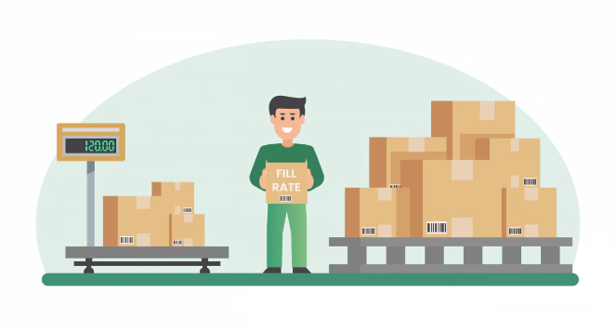


Volume Fill Rate
Volume
The total quantity of products shipped compared to the total quantity ordered.
Fill Rate
The percentage of the total order quantity that is successfully delivered.
Measurement
Volume fill rate is calculated as the total quantity shipped divided by the total quantity ordered.
The volume fill rate is a key supply chain metric that measures how effectively the supply chain is meeting customer demand.

Slide 7

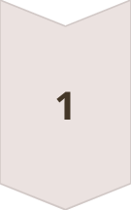
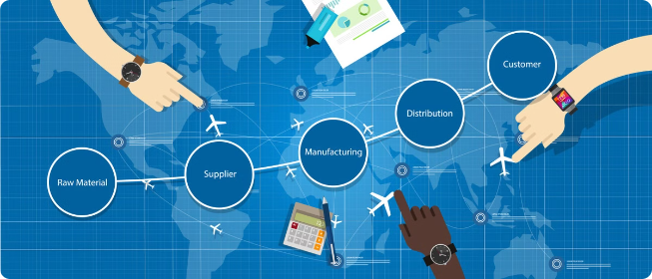


Line Fill Rate
Order Placement
Customers place an order for multiple products.
Inventory Availability
The supply chain must ensure the availability of all ordered items.
Delivery
The complete order, with all line items, is delivered to the customer.
The line fill rate measures the percentage of order lines or individual items that are delivered as per the customer's order. This helps ensure the entire order is fulfilled accurately.

Slide 8


Importance of Supply Chain Metrics
1
Performance Tracking
Supply chain metrics provide a quantitative way to measure the efficiency and effectiveness of the supply chain.
2
Continuous Improvement
By monitoring key metrics, organizations can identify areas for improvement and implement strategic changes to optimize their supply chain.
3
Alignment with Goals
Aligning supply chain metrics with overall business objectives ensures the supply chain is supporting the organization's strategic priorities.
4
Competitive Advantage
Excelling in supply chain performance metrics can provide a competitive advantage in the market.
Effective supply chain management relies on the use of key performance indicators (KPIs) to measure and improve various aspects of the supply chain.

Slide 9
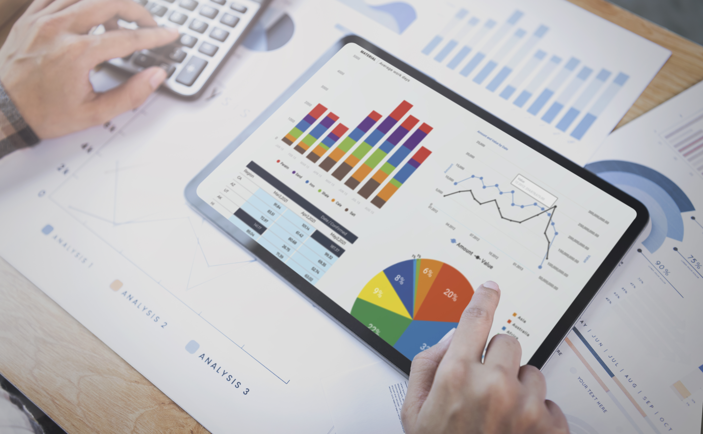
Data Visualization
1
Orders At Glance
Visualize the Stats of Orders
2
Actuals Vs Targets
Compares the Actual and Targets Of Metrics
3
Customer Insights
Visualize the Top Customers
4
Trends For Key Metrics
Data Visual for Key Metrics with Graphs
5
Order Lines At Glance
Visualize the Stats of Order Lines
6
Product Insights
Visualize the Top Products
Click Here For Dashboard

